Slide 1
Molecular Biology Biol 480
Lecture 22 March 20th, 2019

Slide 2
Announcements/Assignments
Topic pick due Wednesday—by 4 pm.
I have received requests to talk about:
CRISPR-CAS9 technology
RNA-seq. (sequencing RNA)
Real-time PCR /quantitative pcr in lab this week

Slide 3
Where were we?
Beginning to explain the mechanism of translation. How did scientists ultimately figure out the central dogma’s details?
By the 1950s, many of the molecules were well studied individually by biochemists.
DNA
RNA
Protein

Slide 4
Despite many attempts to link DNA directly to protein synthesis, several scientists, including Francois Jacob, and Jacques Monod (who figured out bacterial operons like the lac operon) , hypothesized that an intermediate molecule was necessary to produce a protein from a DNA code.

Slide 5
Read again how scientists discovered mRNA using bacteria and bacteriophages. (13.9)
They were able to use molecular hybridization to show sequence similarity between RNA and DNA from the same organisms.

Slide 6
Once it was established that mRNA held the actual code for protein synthesis, lots of experiments were done to show how the code worked.
mRNA, like DNA is made with 4 different building blocks NTPs (U, C, G, A)
Sydney Brenner proposed, based on the numbers of building blocks in both types of molecules, a 3-letter RNA code, would be sufficient to encode 20 amino acids.
Explain---mathematically, why at least 3-nucleotide RNA “words” would be needed to encode 20 amino different acids

Slide 7
The “extra” codes suggested a possibility for redundancy, that one amino acid might have more than one 3-letter designation.
Later, the code was show to be degenerate. The actual nature of the degeneracy, helped establish details of the translation machinery.
Let’s look at the code

Slide 8
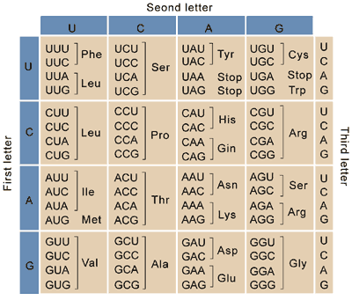
Combinations of 3 could code for 64 amino acids (4³)

Slide 9
Another view---with one letter abbreviation for amino acids

Slide 10
One of the first pieces of evidence supporting a triplet code used bacteriophages (go figure?) and a method for creating insertion or deletions of nucleotides in the genes of the phage.
It was noticed that inserting or deleting one nucleotide usually wiped out the normal activity of a gene—it created a non-functional mutant.

Slide 11
The same occurred if 2 nucleotides were inserted or deleted.
But if 3 or multiples of 3 nucleotides were inserted or deleted, the mutations were often reversed, and at least in some cases, a wild-type phenotype was restored.
This was consisted with the 3-letter code proposed by Brenner. Adding or subtracting 3 nucleotides has only limited effect on how a mRNA is translated.

Slide 12
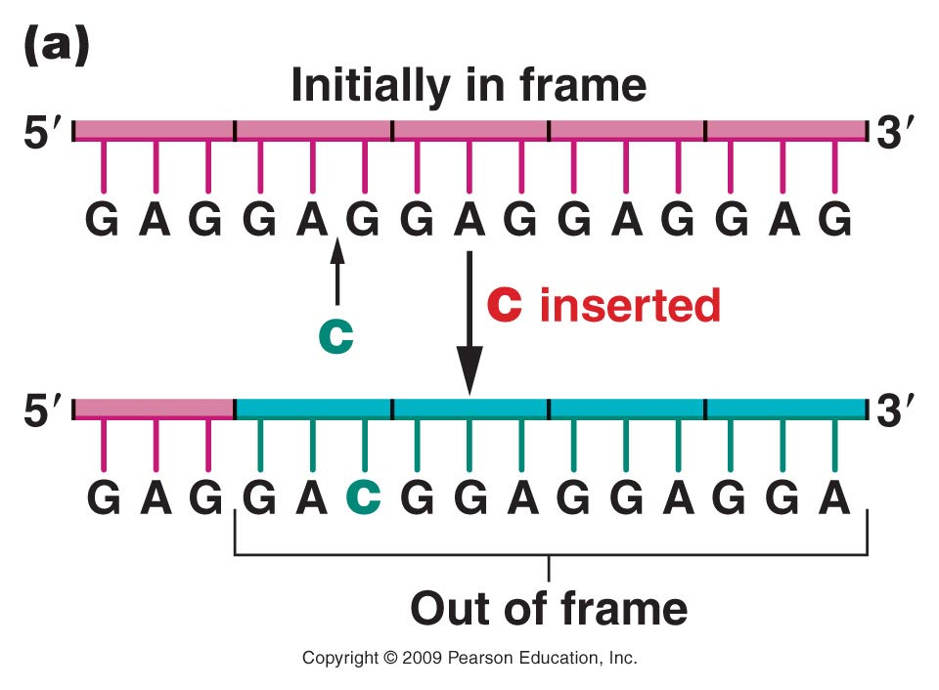
Figure 14.2a
Notes:
Figure 14-2a The effect of frameshift mutations on a DNA sequence repeating the triplet sequence GAG. (a) The insertion of a single nucleotide shifts all subsequent triplet reading frames. (b) The insertion of three nucleotides changes only two codons, but the frame of reading is then reestablished to the original sequence.

Slide 13
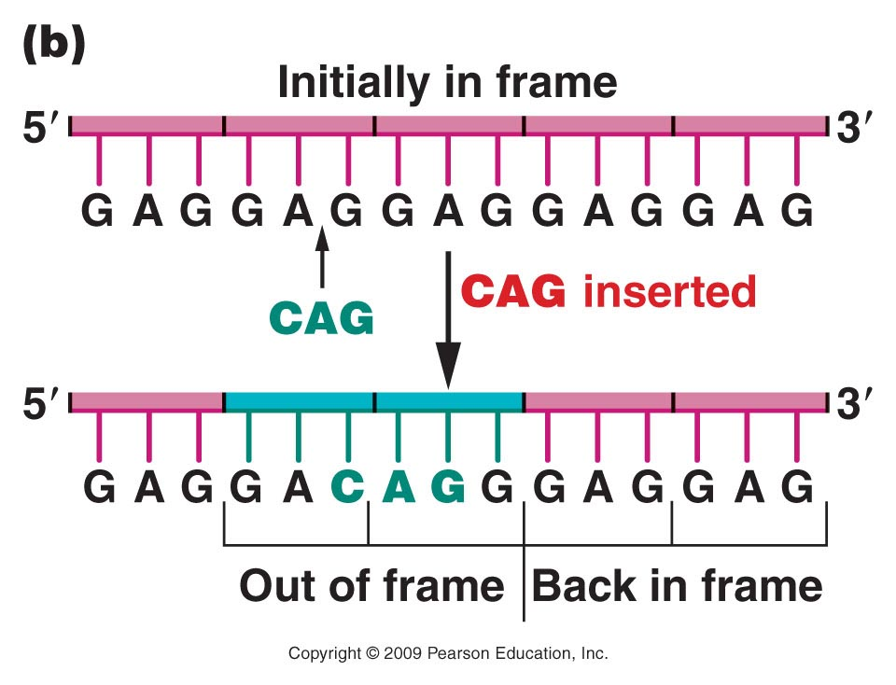
Figure 14.2b
Notes:
Figure 14-2b The effect of frameshift mutations on a DNA sequence repeating the triplet sequence GAG. (a) The insertion of a single nucleotide shifts all subsequent triplet reading frames. (b) The insertion of three nucleotides changes only two codons, but the frame of reading is then reestablished to the original sequence.

Slide 14
The term frame-shift has been used to describe mutations which alter the way in which a triplet code is read in translation.

Slide 15
Brenner did more to describe the code. Since cells like to be economical, he tested an idea that the code could be overlapping.
Perhaps the translation machinery could see every combination of nucleotides even in different frames.

Slide 16
For example…
Which amino acids could be encoded in this sequence if overlap of the code was allowed.
GUACA

Slide 17
Brenner (now 92) is a smart cookie…
He showed that an overlapping code actually limits the linear order of certain amino acids. If you consider one central amino acid and look for specific combinations including that amino acid, you cannot find every possible combination using an overlapping code.
Brenner compared many proteins and found no such limitations in amino acid combinations. He concluded the code is not overlapping.

Slide 18
Francis Crick proposed that the code would be read continuously (without skipping any letters), and that some of the triplet codes were extra, non-coding, and would be ignored.
He referred to the lack of skipping as “commaless”, and to the meaningless codes as nonsense codons.

Slide 19
We now know that the commaless aspect of the code is correct.
But Crick was wrong in his idea that only certain triplet codes had meaning. We now know, that the code is degenerate/redundant. There are no nonsense codons, but some amino acids can be encoded by more than one 3-letter sequence/codon.
Again, look at the genetic code.

Slide 20
Practice explaining/writing this
The genetic code is unambiguous, but redundant.

Slide 21
Cracking the code…Studies by Nirenberg, Matthaei, and others
To actually determine which triplet code (s) specify which amino acids, in vitro translation assays were developed.
Biochemists had identified RNA synthesizing enzymes, some of which could synthesize RNA without a DNA template.
We’ve already mentioned one---the enzyme that adds the poly A tail to the 3’ end of mRNA in eukaryotes. Poly-A polymerase

Slide 22
This was an essential aspect of the code cracking assays in that one could control to a certain extent the sequence of the RNA produced.
Cell extracts were used which allowed proteins to be made in the cell-free system.

Slide 23
Controlling how mRNA was made in a cell-free system
If specific nucleotides were fed into the system—specific RNA sequence was produced

Slide 24
In the 1960s scientists were limited by technology to merely testing certain combinations in RNA sequence with the ability to build proteins out of certain amino acids.
The combinations were:
homopolymers---all the same nucleotide or
mixed copolymers---repeating sequence of 2 nucleotides

Slide 25
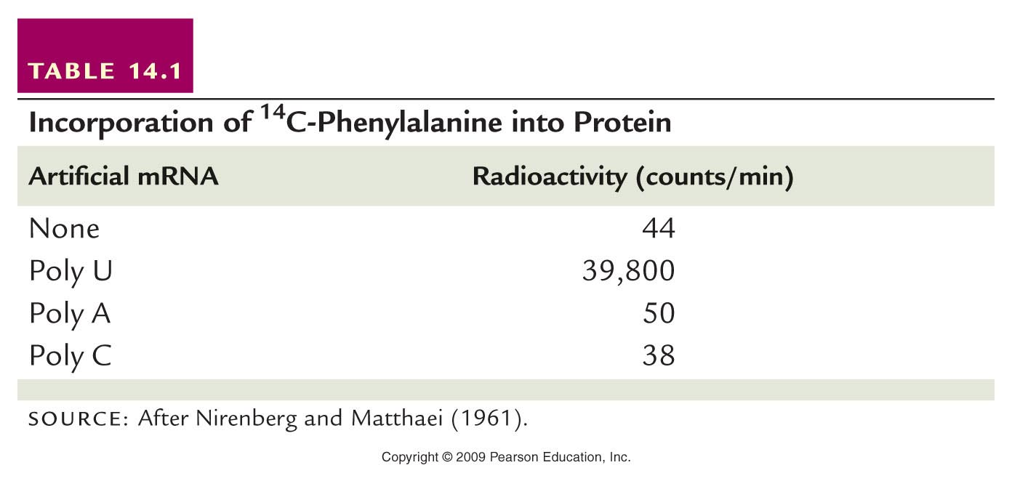
Radiolabeled amino acids were fed into the system. The result of translation was monitored using radioactivity detection.
What is your conclusion from this example experiment?
Table 13.1
Notes:
Table 13-1 Incorporation of ¹⁴C-Phenylalanine into Protein

Slide 26
Test your understanding here...Create a table of other homopolymers and predict which amino acids would be incorporated.

Slide 27
Other assays/tests confirmed codes for amino acids and showed more about how the process of translation worked.
One assay tested how certain mRNA sequences (triplets) bind to tRNAs carrying specific amino acids (more soon on tRNA)

Slide 28
Triplet binding assay
Advances in technology and additional understanding of protein synthesis led to an assay called at triplet binding assay. Small RNAs called transfer RNAs (tRNAs) were known to carry specific amino acids to a growing protein.
A synthetic RNA was tested to see which type of tRNA it bound. The tRNA was analyzed to see which amino acid it bound.

Slide 29
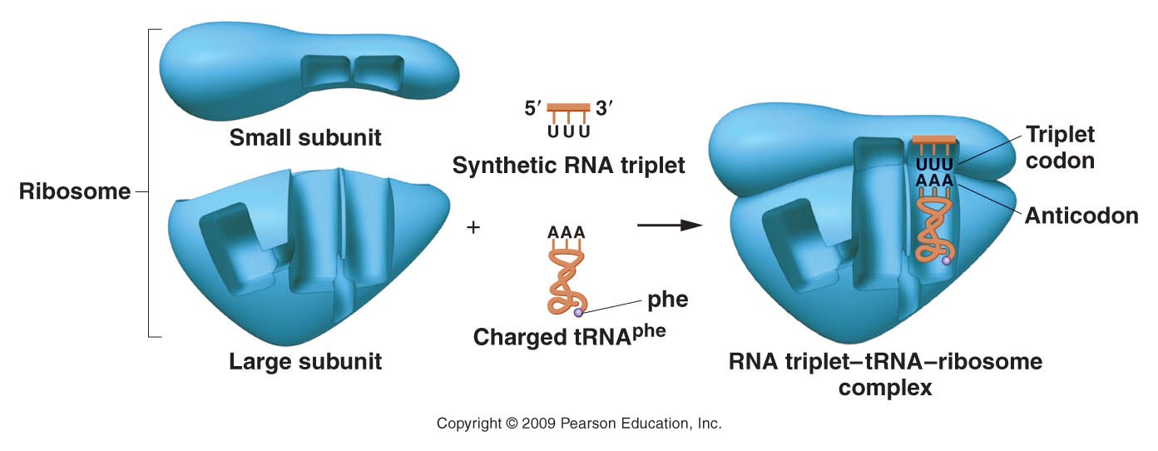
Figure 13.5
Figure 14-5 Copyright © 2006 Pearson Prentice Hall, Inc.
Notes:
Figure 13-5 An example of the triplet-binding assay. The UUU triplet acts as a codon, attracting the complementary tRNAphe anticodon AAA.

Slide 30
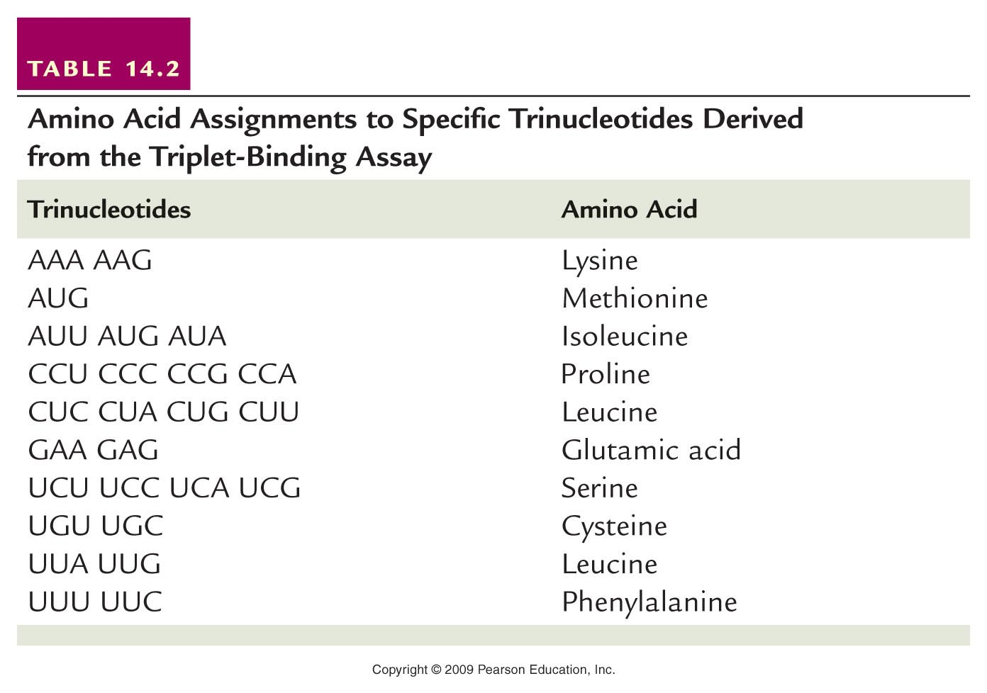
Table 13.2
Notes:
Table 13-2 Amino Acid Assignments to Specific Trinucleotides Derived from the Triplet-Binding Assay

Slide 31
What if combinations of nucleotides were combined.
What RNA sequence could you make with U and G combined--repeating?
UGUGUGUGUGUGUGU---Find the triplet codes possible here…When this experiment was done, only 2 amino acids were incorporated into proteins. Cystein and Valine
Other codes were worked out using similar repeating copolymers of 2, 3, and 4 nucleotides.

Slide 32
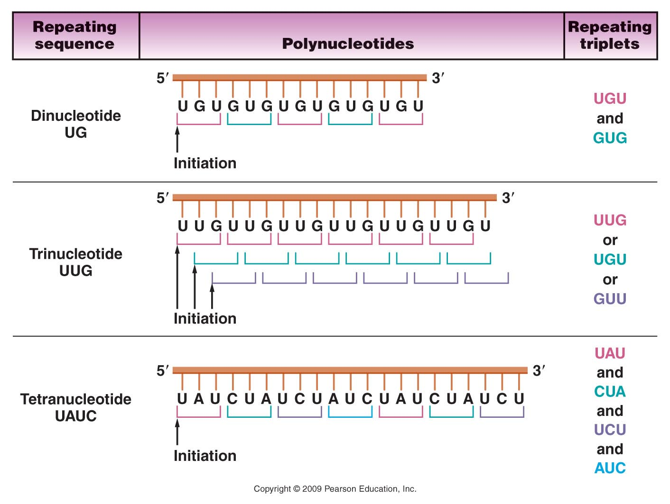
Figure 13.6
Notes:
Figure 13-6 The conversion of di-, tri-, and tetranucleotides into repeating copolymers. The triplet codons produced in each case are shown.

Slide 33
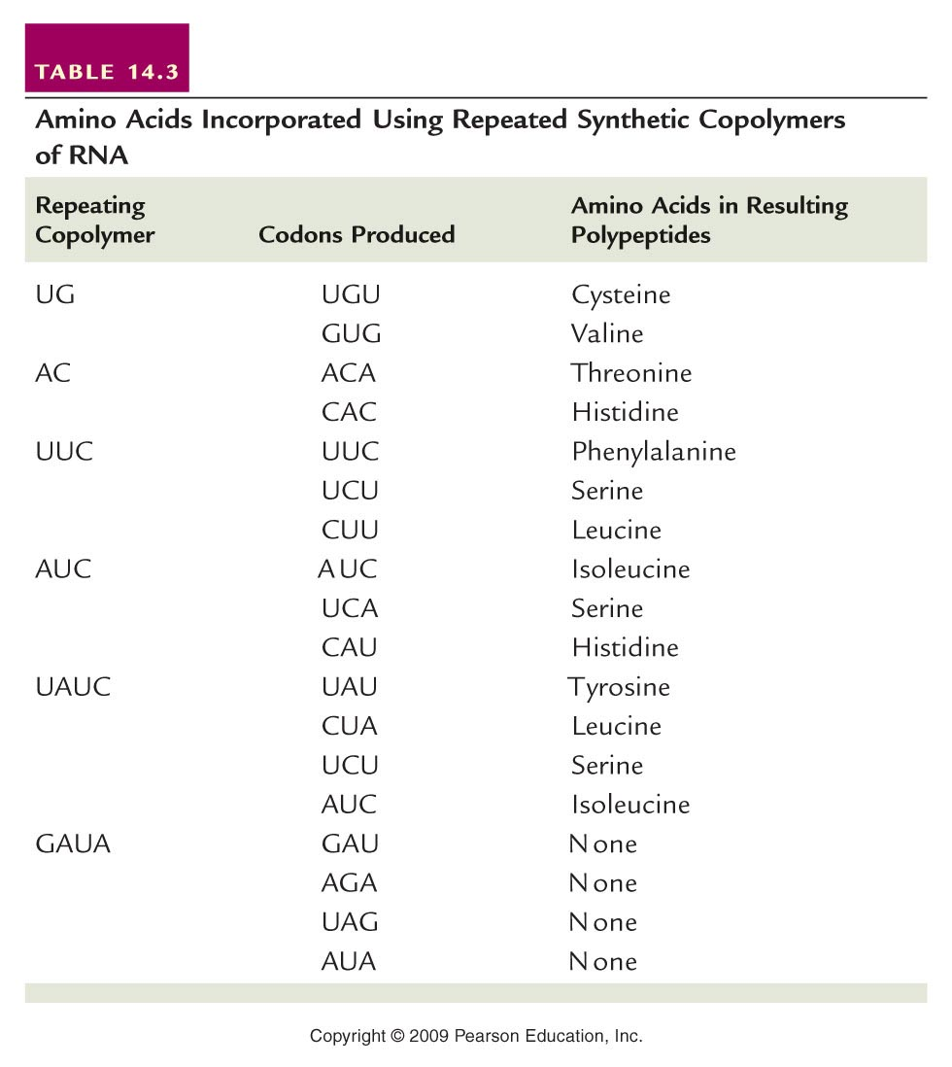
Table 13.3
Notes:
Table 13-3 Amino Acids Incorporated Using Repeated Synthetic Copolymers of RNA

Slide 34
Universal Genetic Code

Slide 35
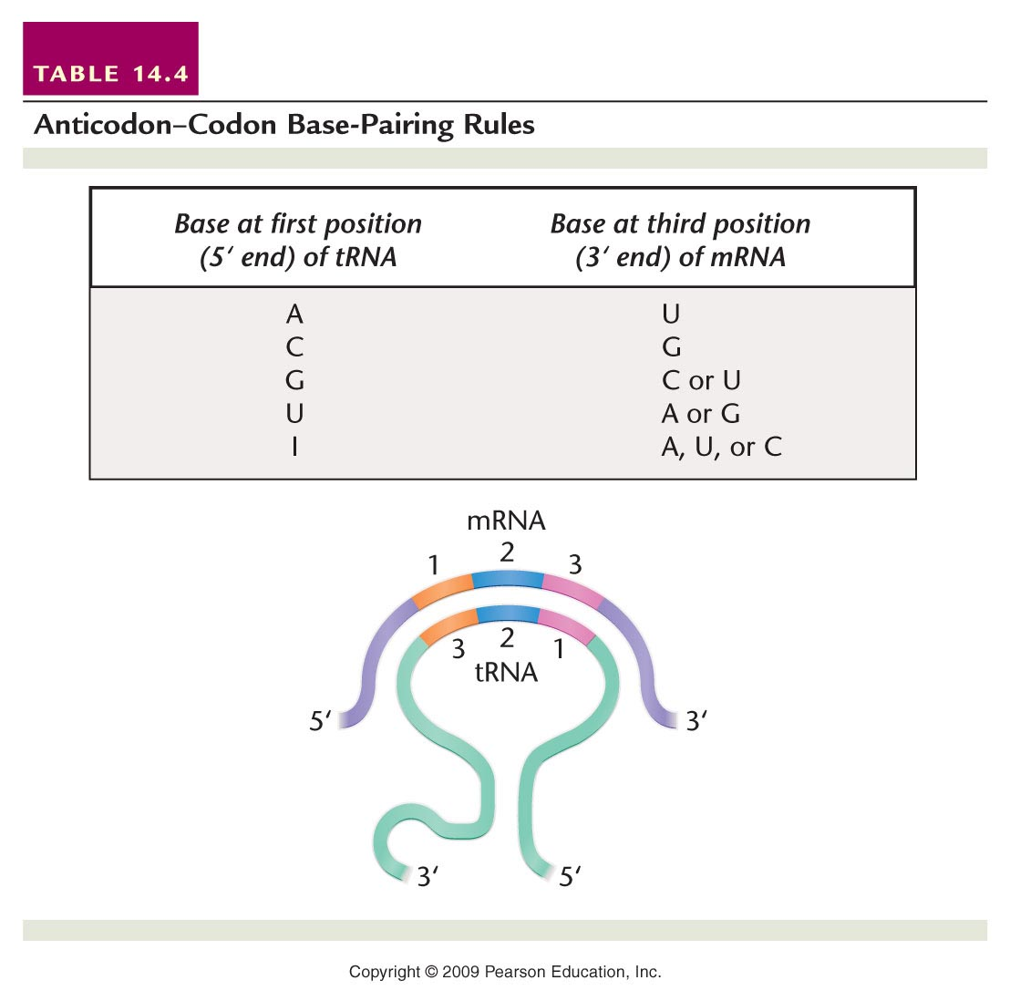
Be sure to analyze how a specific triplet sequence is “recognized” ---Complementary base-pairing—note orientation of mRNA and tRNA strands.
Table 14.4
Notes:
Table 14-4 Anticodon–Codon Base-Pairing Rules

Slide 36
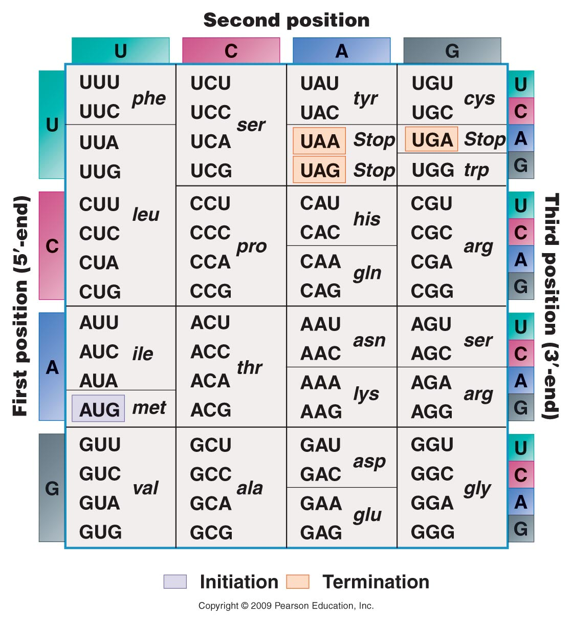
Recall the
degenerate nature
Of the code…Is it
random? Or is
there a noticeable
pattern?

Slide 37
Francis Crick suggested the degenerate nature of the code could be explained by the base-pairing of the triplet codon code and the complementary anticodon of the of the tRNA.
Francis Crick, as you recall, knew a great deal about complementary base pairing!

Slide 38
He hypothesized, that since the codon-anticodon base pairing involved only 3 nucleotides, that there was some “wiggle room” or as Crick put it, wobble room which allowed non-complementary base pairs to form.
This became known as the Wobble hypothesis.

Slide 39
Not every base-pair is possible, but sometimes G can pair with U.
And sometimes U can pair with G…
And inosine (a modified RNA base found in tRNA) can base pair with A, C, or U.

Slide 40
Table 14.4
Notes:
Table 14-4 Anticodon–Codon Base-Pairing Rules

Slide 41
What might this mean for cells and the tRNAs they make? Do they need to perfectly match each codon with a complementary tRNA anticodon?
Might this give organisms an economical advantage?

